Slide 1
Dynamic Data Structures and Generics
Chapter 12

Slide 2
Objectives
Define and use an instance of ArrayList
Introduction to the Java Collections Framework
Describe general idea of linked list data structures and implementation
Manipulate linked lists
Use inner classes in defining linked data structures
Describe, create, use iterators
Define, us classes with generic types

Slide 3
Array-Based Data Structures: Outline
The Class ArrayList
Creating an Instance of ArrayList
Using Methods of ArrayList
Programming Example: A To-Do List
Parameterized Classes and Generic Data Types

Slide 4
Class ArrayList
Consider limitations of Java arrays
Array length is not dynamically changeable
Possible to create a new, larger array and copy elements – but this is awkward, contrived
More elegant solution is use instance of ArrayList
Length is changeable at run time

Slide 5
Class ArrayList
Drawbacks of using ArrayList
Less efficient than using an array
Can only store objects
Cannot store primitive types
Implementation
Actually does use arrays
Expands capacity in manner previously suggested

Slide 6
Class ArrayList
Class ArrayList is an implementation of an Abstract Data Type (ADT) called a list
Elements can be added
At end
At beginning
In between items
Possible to edit, delete, access, and count entries in the list

Slide 7
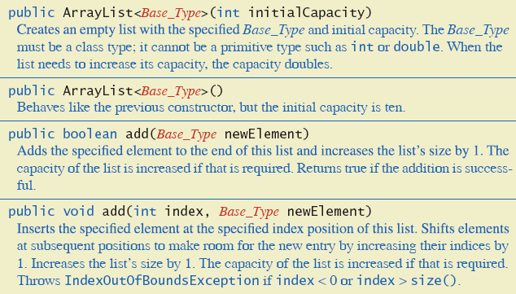
Class ArrayList
Figure 12.1a Methods of class ArrayList

Slide 8
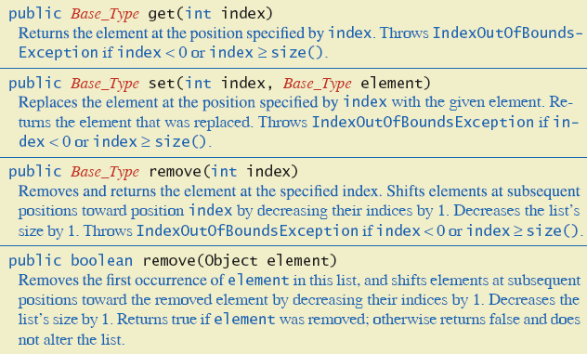
Class ArrayList
Figure 12.1b Methods of class ArrayList

Slide 9
Creating Instance of ArrayList
Necessary to import java.util.ArrayList;
Create and name instance ArrayList<String> list = new ArrayList<String>(20);
This list will
Hold String objects
Initially hold up to 20 elements

Slide 10
Using Methods of ArrayList
Object of an ArrayList used like an array
But methods must be used
Not square bracket notation
Given ArrayList<String> aList = new ArrayList<String>(20);
Assign a value with aList.add(index, "Hi Mom"); aList.set(index, "Yo Dad");

Slide 11
Programming Example
A To-Do List
Maintains a list of everyday tasks
User enters as many as desired
Program displays the list
View source code, listing 12.1 class ArrayListDemo

Slide 12
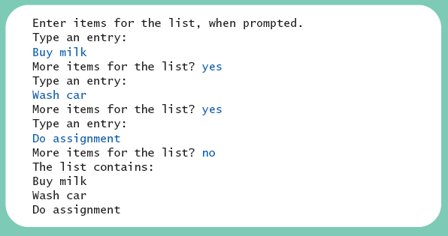
Programming Example
Sample screen output

Slide 13
Programming Example
When accessing all elements of an ArrayList object
Use a For-Each loop
Use the trimToSize method to save memory
To copy an ArrayList
Do not use just an assignment statement
Use the clone method

Slide 14
Parameterized Classes, Generic Data Types
Class ArrayList is a parameterized class
It has a parameter which is a type
Possible to declare our own classes which use types as parameters
Note earlier versions of Java had a type of ArrayList that was not parameterized

Slide 15
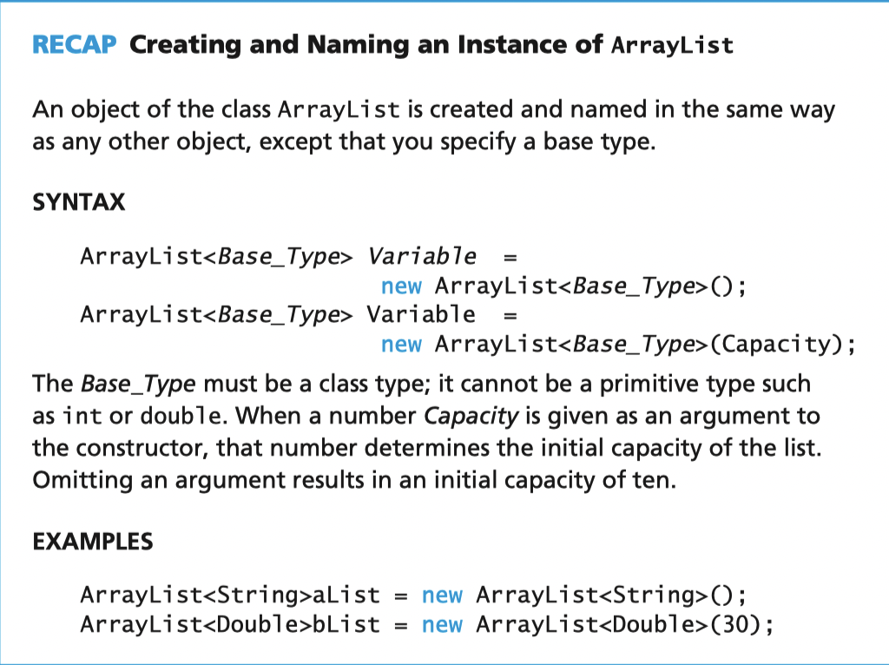

Slide 16
The Java Collections Framework
A collection of interfaces and classes that implement useful data structures and algorithms
The Collection interface specifies how objects can be added, removed, or accessed from a Collection
Brief introduction to just two implementations, HashSet and HashMap
See other references for more info

Slide 17
HashSet Class
Used to store a set of objects
Uses the same <> notation as an ArrayList to specify the data type
View source code, listing 12.2 class HashSetDemo
If you use HashSet of your own class, it must override hashCode() and equals()

Slide 18
HashMap Class
Used like a database to efficiently map from a key to an object
Uses the same <> notation as an ArrayList to specify the data type of both the key and object
View source code, listing 12.3 class HashMapDemo
If you use HashMap of your own class as key, it must override hashCode() and equals()

Slide 19
Linked Data Structures:Outline
The Class LinkedList
Linked Lists
Implementing Operations of a Linked List
A Privacy Leak
Inner Classes

Slide 20
Linked Data Structures:Outline
Node Inner Classes
Iterators
The Java Iterator Interface
Exception Handling with Linked Lists
Variations on a Linked List
Other Linked Data Structures

Slide 21
Class LinkedList
Linked data structure
Collection of objects
Each object contains data and a reference to another object in the collection
Java provides a class to do this, LinkedList
More efficient memory use than ArrayList
We will write our own version to learn the concepts of a linked list

Slide 22
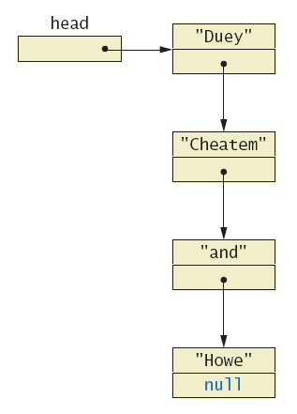
Linked Lists
A dynamic data structure
Links items in a list to one another
Figure 12.4, a linked list

Slide 23
Linked Lists
Node of a linked list object requires two instance variables
Data
Link
View sample class, listing 12.4 class ListNode
This example has String data
Note the link, a reference to the type which is the class

Slide 24
Implementing Operations of Linked Lists
Now we create a linked list class which uses the node class
View class, listing 12.5 class StringLinkedList
Note the single instance variable of type ListNode
Note method to traverse and print the contents of the list

Slide 25
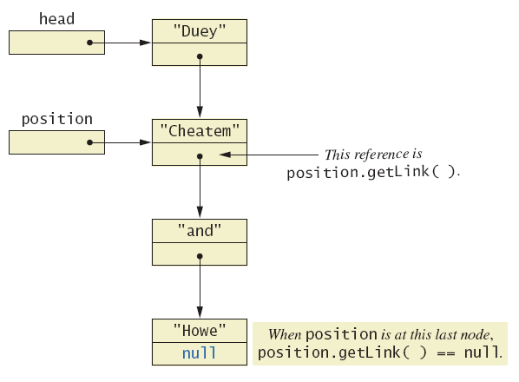
Implementing Operations of Linked Lists
Figure 12.5 Moving down a linked list

Slide 26
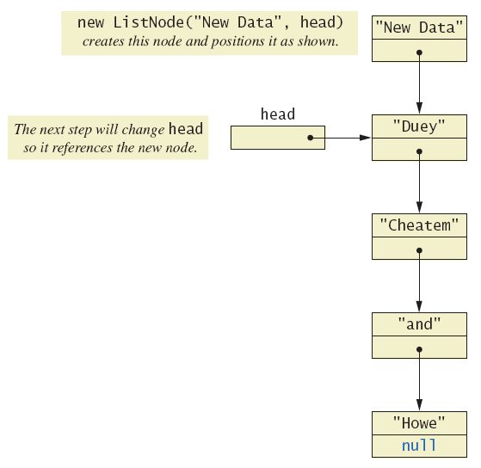
Implementing Operations of Linked Lists
Figure 12.6 Adding a node at the start of a linked list

Slide 27
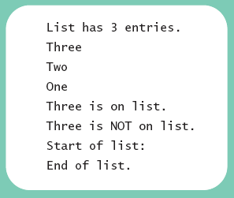
Implementing Operations of Linked Lists
View linked-list demonstration, listing 12.6 class StringLinkedListDemo
Sample screen output

Slide 28
Implementing Operations of Linked Lists
Java automatically returns memory used by deleted node to the operating system.
Called automatic garbage collecting
In this context, note the significance of NullPointerException messages
Consider the fact that our program has a reference (name) to only the head node

Slide 29
A Privacy Leak
Note results of getLink in class ListNode
Returns reference to ListNode
This is a reference to an instance variable of a class type … which is supposed to be private
Typical solution is to make ListNode a private inner class of StringLinkedList

Slide 30
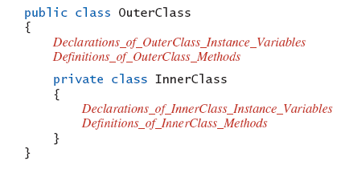
Inner Classes
Defined within other classes
Example

Slide 31
Inner Classes
Inner class definition local to the outer-class definition
Inner-class definition usable anywhere within definition of outer class
Methods of inner and outer classes have access to each other's methods, instance variables

Slide 32
Node Inner Classes
We show ListNode as a private inner class
This is safer design
Hides method getLink from world outside StringLinkedList definition
View new version, listing 12.7 class StringLinkedListSelfContained

Slide 33
Iterators
A variable that allows you to step through a collection of nodes in a linked list
For arrays, we use an integer
Common to place elements of a linked list into an array
For display purposes, array is easily traversed
View method to do this, listing 12.8 method toArray

Slide 34
Iterators
Consider an iterator that will move through a linked list
Allow manipulation of the data at the nodes
Allow insertion, deletion of nodes
View sample code, listing 12.9 class StringLinkedListWithIterator

Slide 35
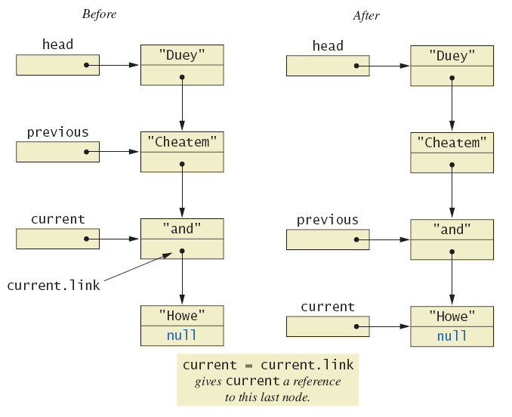
Iterators
Figure 12.7 The effect of goToNext on a linked list

Slide 36
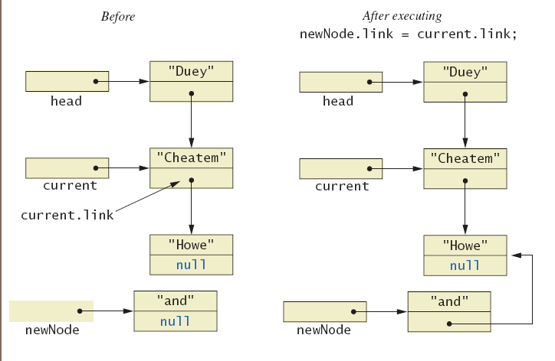
Iterators
Figure 12.8a Adding node to linked list using insertAfterIterator

Slide 37
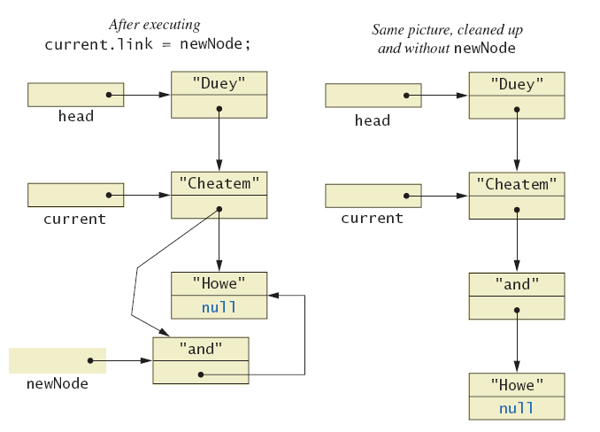
Iterators
Figure 12.8b Adding node to linked list using insertAfterIterator

Slide 38
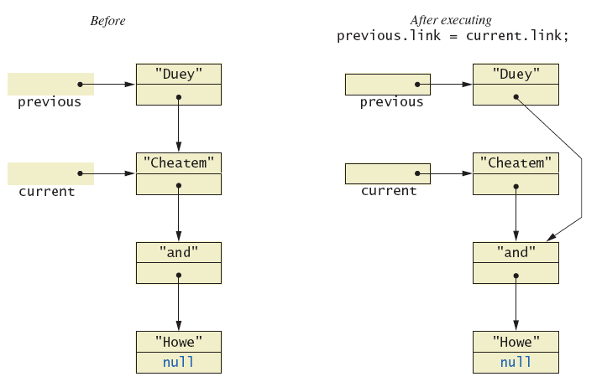
Iterators
Figure 12.9a Deleting a node

Slide 39
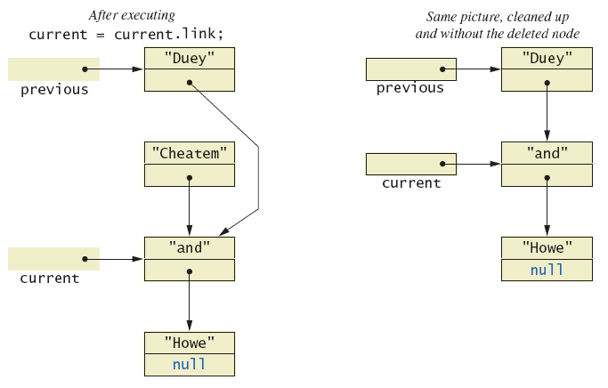
Iterators
Figure 12.9b Deleting a node

Slide 40
Java Iterator Interface
Java formally considers an iterator to be an object
Note interface named Iterator with methods
hasNext – returns boolean value
next – returns next element in iteration
remove – removes element most recently returned by next method

Slide 41
Exception Handling with Linked Lists
Recall class StringLinkedListWithIterator
Methods written so that errors caused screen message and program end
More elegant solution is to have them throw exceptions
Programmer decides how to handle
Note class which does this, listing 12.10 class LinkedListException

Slide 42
Variations on a Linked List
Possible to make a linked where data element is of any type
Replace type String in definition of node class with desired data type
Consider keeping a reference to last node in list
Called the tail of the list
Constructors, methods modified to accommodate new reference

Slide 43
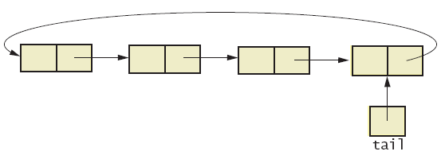
Variations on a Linked List
Consider having last link point back to head
Creates a circular linked list
Figure 12.10 Circular linked list

Slide 44
Variations on a Linked List
Also possible to have backward as well as forward links in the list
Doubly linked list
Possible to traverse in either direction
Figure 12.11 Doubly linked list

Slide 45
Other Linked Data Structures
Stack
Elements removed from ADT in reverse order of initial insertion
Can be implemented with linked list
Tree
Each node leads to multiple other nodes
Binary tree leads to at most two other nodes

Slide 46
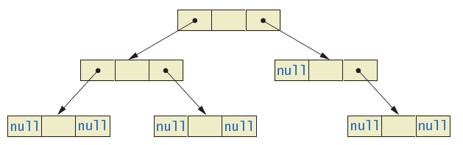
Other Linked Data Structures
Figure 12.12 Binary tree

Slide 47
Generics: Outline
The Basics
Programming Example: A Generic Linked List

Slide 48
Basics of Generics
Beginning with Java 5.0, class definitions may include parameters for types
Called generics
Programmer now can specify any class type for the type parameter
View class definition, listing 12.11 class Sample<T>
Note use of <T> for the type parameter

Slide 49
Basics of Generics
Legal to use parameter T almost anywhere you can use class type
Cannot use type parameter when allocating memory such as anArray = new T[20];
Example declaration Sample <String> sample1 = new Sample<String>();
Cannot specify a primitive type for the type parameter

Slide 50
Programming Example
Generic linked list
Revision of listing 12.5
Use type parameter E instead of String
Note similarities and differences of parameterized class with non-paramaterized classes
View generic class, listing 12.12 class LinkedList <E>

Slide 51

Programming Example
View demo program, listing 12.13 class LinkedListDemo
Sample screen output

Slide 52
Graphics Supplement
The Scene Builder can simplify the creation of JavaFX GUI applications by providing a graphical way to arrange the components on a form
Binaries of the Scene Builder available from Gluon Labs
http://gluonhq.com/labs/scene-builder
Use in conjunction with an IDE such as NetBeans or Eclipse
Consult your IDE documentation for further information on integration
JavaFX applications split up into three files that separate the layout from the code logic
FXML file – contains information about the presentation and layout of nodes but no code for what happens when events occur
Application file – Java source code that contains the start method and typically loads the FXML file
Controller file – Java source code that implements event handlers that respond to the UI controls

Slide 53
Sample FXML File
Can build the FXML file by hand, similar to HTML. Example file:
This file is what is built automatically for us by the scene builder!

Slide 54
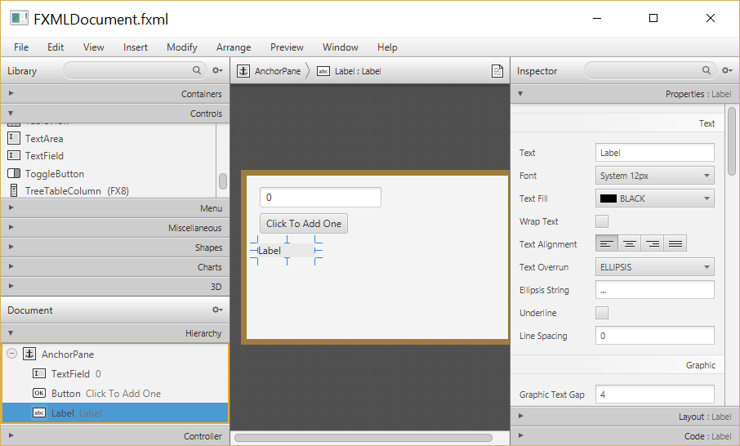
Scene Builder UI
Drag controls from the library to the view in the middle
The AnchorPane allows us to anchor the sides of a control to edges in the pane

Slide 55
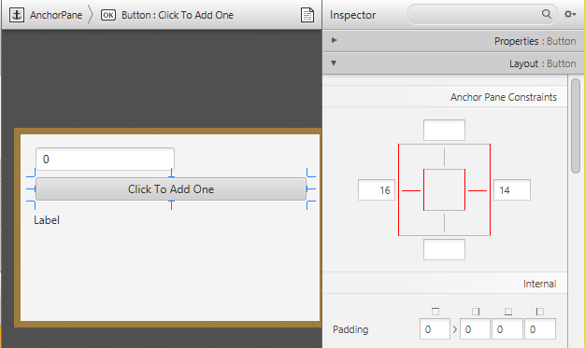
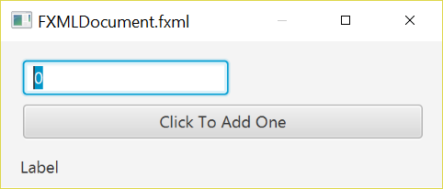
Scene Builder UI
Anchoring a Button to the left and right sides of the pane using Scene Builder 2.0
Preview Window

Slide 56
The JavaFX Application Class
This class loads the FXML document in the start method
It is typically created automatically by the IDE
View JavaFX application class, listing 12.14 class JavaFXApp

Slide 57
The JavaFX Application Class
This class loads the FXML document in the start method
It is typically created automatically by the IDE
View JavaFX application class, listing 12.14 class JavaFXApp

Slide 58
The JavaFX Controller Class
This class contains event handlers for controls in the GUI
We need to link variables in the controller to the controls in the Scene Builder
Add the @FXML annotation above the class variable and event handler that corresponds to the control in the Scene Builder
E.g. for a Button in the Scene Builder we would add this in the controller class
You would use the variable name of your choice

Slide 59
The JavaFX Controller Class
The class variable and event handler method need to be linked to the corresponding component in the Scene Builder

Slide 60
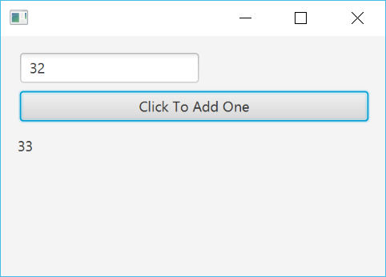
The JavaFX Controller Class
View JavaFX controller class, listing 12.15 class JavaFXAppController
Sample Output of
Final Program

Slide 61
Summary
Java Class Library includes ArrayList
Like an array that can grow in length
Includes methods to manipulate the list
Java Collections Framework contains many classes to store and manipulate objects
Linked list data structure contains nodes (objects)
Linked data structure is self-contained by making the node class an inner class

Slide 62
Summary
Variable or object which allows stepping through linked list called an iterator
Class can be declared with type parameter
Object of a parameterized class replaces type parameter with an actual class type
Classes ArrayList,HashSet,HashMap and LinkedList are parameterized classes
The Scene Builder provides a graphical way to construct JavaFX applciations

